Slide 1


Performance Insights & Strategic Analysis
Prepared by: [Riya]
Data Analyst Internship - Task 4
June 2025

Slide 2






Executive Summary
Retail Analytics Dashboard - Performance Overview
Dashboard Overview
This analytics dashboard provides a comprehensive view of retail performance metrics through several key visualizations:
Key Performance Metrics
Data Visualizations
Total Sales:
$2.30M
Customer Segment Distribution (pie chart)
Total Profit:
$286.40K
Revenue Trend Analysis (line chart)
Units Sold:
38K
units
Product Category Distribution (scatter plot)
This dashboard enables executives to monitor critical business metrics, identify growth opportunities, analyze customer behavior patterns, and optimize product portfolio performance.
Strategic Purpose:

Slide 3






Performance Metrics
Key Performance Indicators
The dashboard highlights three critical business metrics that provide an executive overview of retail performance:
$2.30M
$286.40K
38K
Total Sales
Total Profit
Units Sold
Performance Analysis
Profit Margin Analysis
Average Order Value
Based on the KPIs, the overall profit margin is approximately
The average revenue per unit is approximately
($2.30M sales / 38K units).
$60.53
12.45%
($286.40K profit on $2.30M sales).
This indicates a healthy profit margin for retail, suggesting effective pricing strategies and cost management.
This suggests a mid-to-high price point product mix, typical for an office supply and technology retailer.
Profit per Unit
Performance Indicators
The average profit per unit is approximately
The dashboard reveals a direct correlation between sales volume and profit generation, with consistent profit margins across the business.
($286.40K profit / 38K units).
$7.54
This metric helps in evaluating product performance and can guide inventory and purchasing decisions.
These KPIs provide a foundation for deeper analysis of segment and category performance.

Slide 4




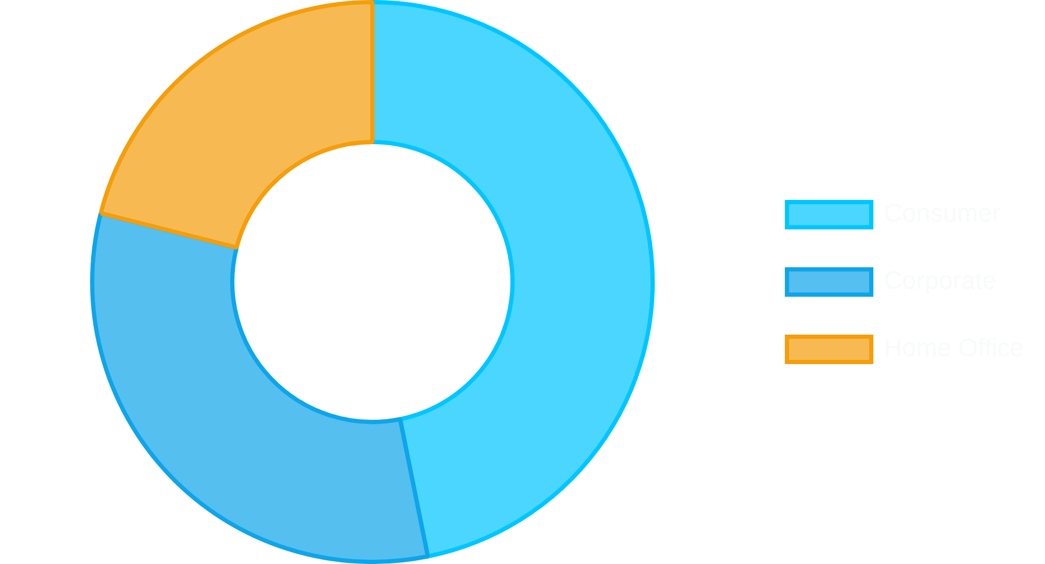



Customer Segment Distribution
Segment Analysis
Segment Breakdown
The dashboard reveals profit distribution across three distinct customer segments, with Consumer segment leading in overall contribution.
Consumer
$134.12K
Profit Contribution
46.83%
Corporate
$91.98K
Profit Contribution
32.12%
Home Office
$60.3K
Profit Contribution
21.05%
Segment Performance Insights
Strategic Implications
Consumer segment
Prioritize marketing investments in the Consumer segment to maximize ROI.
generates the highest profit at $134.12K (46.83% of total), making it the most valuable customer group.
Develop targeted growth strategies for Corporate segment to increase market share.
Corporate customers
contribute $91.98K (32.12%), representing significant business potential with room for growth.
Evaluate product offerings for Home Office to identify expansion opportunities.
Home Office
is the smallest segment at $60.3K (21.05%), but still represents over one-fifth of total profits.
Implement segment-specific promotions based on profit contribution patterns.

Slide 5



Revenue Trend Analysis
Sales by Order Date
The dashboard reveals a distinctive sales trend pattern over time, with significant insights visible in the "Sum of Sales by Order Date" visualization.
Initial Revenue Peak
Progressive Decline
The chart displays a substantial sales peak at the beginning of the time period (approximately 30K), followed by a pronounced decline.
Following the initial peak, sales exhibit a gradual downward trend over time, eventually stabilizing around the 10K level in later periods.
Periodic Fluctuations
Terminal Stabilization
The trend line reveals minor oscillations throughout the timeline, indicating potential seasonal or cyclical sales patterns.
Toward the conclusion of the timeline, sales appear to reach equilibrium, suggesting a potential market stabilization or established customer base.
Strategic Implications
1
Historical Context:
Investigate the factors behind the initial high sales peak to understand if it was a one-time event or a repeatable success.
2
Trend Analysis:
The overall declining trend suggests a need to evaluate product lifecycle, market saturation, or competitive pressures.
3
Forecasting:
The recent stabilization provides a baseline for future sales projections and inventory planning.
4
Growth Opportunities:
Consider marketing initiatives or product innovations to reverse the declining trend and stimulate new growth.

Slide 6
















Product Portfolio Analysis
Category & Sub-Category Distribution
The dashboard features a scatter plot visualization revealing the distribution patterns of product categories by sales and sub-categories, providing insights into portfolio performance.
Key Distribution Patterns
Sub-Category Analysis
The visualization reveals a concentration of sub-categories in the lower sales range (below 5K), indicating a long-tail distribution pattern.
Accessories
Appliances
Art
Binders
Multiple sub-categories demonstrate higher frequency (vertical axis) but relatively modest sales performance.
Bookcases
Chairs
Several outlier sub-categories emerge in the higher sales ranges (10K-20K), representing potential high-value product lines.
Copiers
Envelopes
The color-coded visualization effectively distinguishes between different sub-categories, enabling rapid pattern identification.
Strategic Portfolio Insights
Product Diversity
Revenue Distribution
The extensive distribution of sub-categories indicates a diverse product portfolio, which mitigates risk but may dilute strategic focus.
Most sub-categories generate modest sales volumes, with a select few high-performers driving significant revenue contribution.
Inventory Optimization
Growth Opportunities
High-frequency, low-sales sub-categories may indicate inventory inefficiencies that could be addressed through portfolio rationalization.
Identifying which sub-categories represent outliers in the higher sales ranges can inform targeted product expansion strategies.

Slide 7











Strategic Insights
Key Dashboard Insights
Business Performance Metrics
With $2.30M in sales and $286.40K in profit, the business maintains a healthy 12.45% profit margin across 38K units sold.
This indicates effective pricing strategies and operational efficiency in the retail environment.
Customer Segment Analysis
Consumer segment drives 46.83% of total profits ($134.12K), making it the most valuable customer group.
Corporate (32.12%) and Home Office (21.05%) segments provide balanced diversification but show growth potential.
Revenue Trend Patterns
The sales trend shows an initial peak followed by gradual decline and recent stabilization around 10K levels.
This pattern suggests market maturation and the need for strategic initiatives to stimulate growth.
Product Portfolio Diversity
The scatter plot reveals a diverse product portfolio with multiple sub-categories, most concentrated in lower sales ranges.
This diversity provides risk mitigation but may indicate opportunities for portfolio optimization.
Strategic Recommendations
Consumer Segment Focus
Corporate Growth Strategy
Prioritize marketing investments in the Consumer segment to maximize ROI, as this segment generates the highest profit contribution (46.83%).
Develop targeted B2B strategies to increase corporate segment share (currently 32.12%), potentially through volume discounts and specialized service offerings.
Revenue Growth Initiatives
Portfolio Optimization
Implement strategic growth initiatives such as new product launches, market expansion, or promotional campaigns to counter the declining sales trend.
Analyze low-performing sub-categories for potential discontinuation and focus resources on high-performing product lines to improve overall profitability.

Slide 8








Interactive Capabilities
Dashboard Interactivity Features
Your Retail Analytics Dashboard includes sophisticated interactive features that enhance data exploration and decision-making:
Advanced Filtering
Cross-Visual Filtering
The dashboard incorporates dynamic data slicers for targeted analysis:
The dashboard enables synchronized filtering across visualizations:
1
Sub-Category filter with multi-select capability
1
Click segment slices in the pie chart to filter all other visuals
2
Date range selection with flexible time period options
2
Select data points in scatter plot to highlight related metrics
3
Customer segment selection for targeted analysis
3
Click time periods to focus analysis on specific timeframes
Dynamic Tooltips
Multi-Level Drill-Down
Hovering over data points reveals comprehensive contextual information:
The dashboard supports hierarchical data exploration:
1
Time hierarchy: Year → Quarter → Month → Day
1
Detailed metrics including Sales, Profit, and Quantity
2
Product hierarchy: Category → Sub-category → Product
2
Percentage contribution relative to overall totals
3
Geographic hierarchy: Region → State → City
3
Visualization-specific context and comparative metrics
Interactive Analysis Workflow
Recommended interaction sequence for maximum insight:
1
2
3
4
Select Consumer segment in pie chart
Apply date filter to focus on recent periods
Examine filtered category performance
Drill down to identify specific growth opportunities

